Slide 1
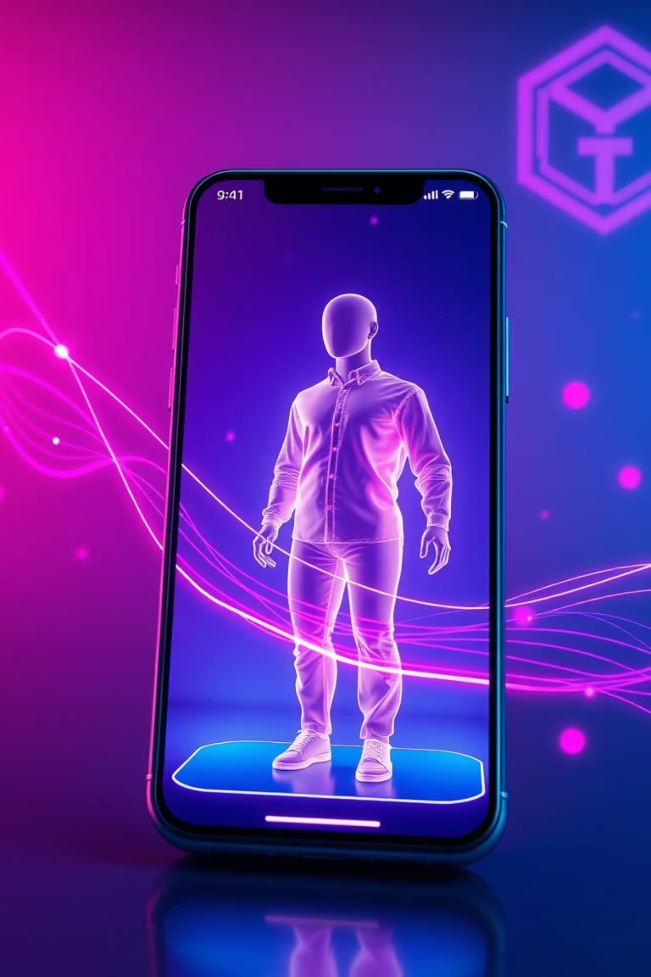
AR-Shopping
Shop Smarter. Try Before You Buy.
Transforming the retail experience with cutting-edge technology.

Slide 2
The Problem: Friction in Online Fashion Retail
Fit & Look Uncertainty
High Return Rates
Shoppers are often unsure if clothes will fit or look good on them, leading to purchase hesitation.
Size mismatches and aesthetic disappointments drive costly and inefficient product returns.
Lack of Personalization
Trust & Security Gaps
Generic online shopping experiences fail to engage customers on a personal level.
Concerns over payment security and data privacy deter potential buyers.

Slide 3





Our Solution: A Seamless, Secure, and Personalized Experience
We're building an e-commerce platform that addresses core pain points with integrated emerging technologies.
AR Try-On
AI Recommender
Blockchain
Payments
Virtual fitting for confident
purchases.
Hyper-personalized product
suggestions.
Secure & transparent
transactions.
Voice AI
Cloud + 5G Edge
Effortless hands-free shopping.
Fast, smooth, and responsive experience.

Slide 4

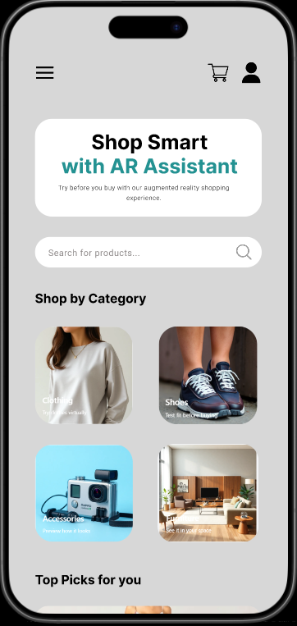
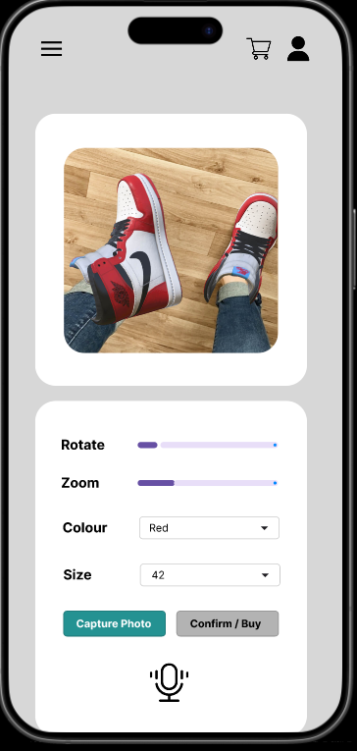
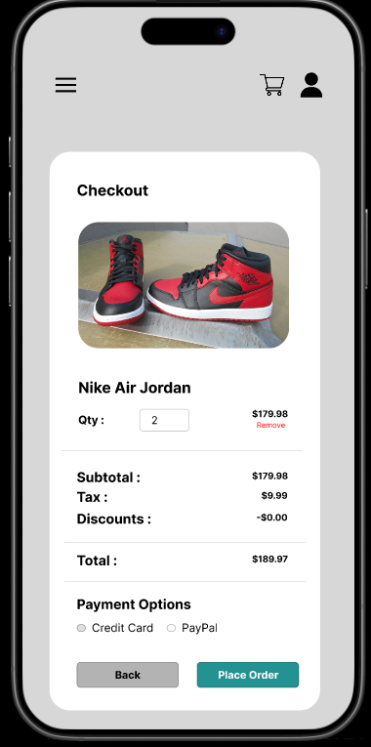
Visualizing the Future: Prototype Walkthrough
Try-On and
Voice Search
Checkout
Screen
Splash Screen
Home Screen
The Figma Prototype

Slide 5
Key Differentiators: Why We Win
Competitors
Our App
Limited AR capabilities.
Full AR Try-On: Unparalleled virtual fitting realism.
Static product catalogs.
AI + Blockchain Security: Intelligent personalization fused with ironclad transactions.
Basic search and filtering.
Traditional payment methods.
Voice & Chatbot Integration: A truly unique,
conversational shopping assistant.
5G Edge Rendering: Superior speed and
smoothness for an immersive experience.
We offer a comprehensive, integrated solution that current market players cannot match, addressing customer
needs holistically.

Slide 6








Powering the Platform: Emerging Technologies
AR
AI/ML
Blockchain
Virtual Try-On
Personalized Suggestions
Secure Payments
NLP &
Voice AI
Cloud
Computing
5G
Low-Latency AR
Voice Shopping
Scalable Backend
Secure
Authentication
Data Analytics
Customer Insights
Biometric Login

Slide 7





Navigating Challenges: Risks & Mitigations
High Development Cost
Start with an MVP focusing on core features, then expand incrementally.
Privacy Concerns
Implement end-to-end encryption and adhere to strict data privacy regulations (GDPR, CCPA).
Blockchain Adoption
Offer hybrid payment options (fiat and crypto) to ease user transition and maximize accessibility.
AR Hardware Limitations
Optimize performance for mid-range smartphones, ensuring broad compatibility without compromising experience.
Connectivity Issues
Provide an offline browsing mode for browsing catalogs, enhancing user experience in varied network conditions.

Slide 8
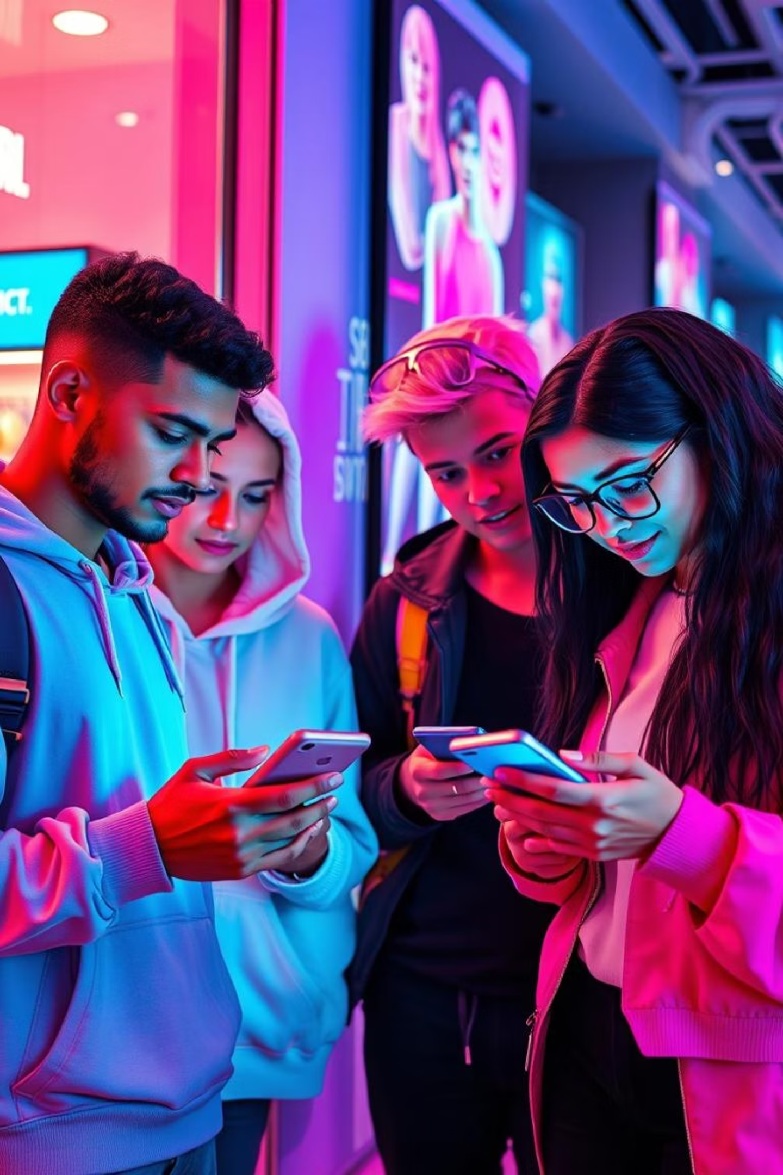
The Path to Profit: Business Plan
Revenue Streams
Strategy & Growth
Commission on Sales from brands.
Phase 1: Partner with emerging and established fashion brands.
Premium AR features subscription.
Phase 2: Scale globally, targeting key retail markets.
Targeted in-app advertisements.
Target Users: Primarily Gen Z and Millennials, along with forward-thinking fashion retailers.
Brand partnership subscriptions.

Slide 9
Conclusion: Ready for Retail's Future
1
Solves Key Pain Points
2
Leverages Emerging
Tech
Directly addresses uncertainty, returns, lack of personalization, and security in online shopping.
Integrates AR, AI, Blockchain, 5G, and Voice
AI for a truly next-gen experience.
3
Secure, Scalable, Future
-Ready
4
Next Steps
Secure funding for prototype refinement,
launch MVP, and begin brand partnerships.
Built for growth and resilience in a rapidly evolving digital landscape.

Slide 10
Contribution to the project
Name of the student
Contribution
COHNDSE242F-026
Report – Chapter 01, 04, 06
COHNDSE242F-027
Report – Chapter 04, 05, 06
COHNDSE242F-041
Report – Chapter 02, 03
COHNDSE242F-042
Prototype and Presentation Slide

Slide 11
Thank You!

